Slide 1

Software Engineering Department
Braude College of Engineering
Final Project – Phase A (61998)
Dynamic Labyrinths - Asymmetric Hunter vs. Builder
CODE: 26-1-D-22
By: Elio Pikuli Maxim Lazarenko
Advisor: PhD. Sulamy Moshe
Link to GitHub: https://github.com/ElioPikuli/Dynamic-Labyrinths---Asymmetric-Hunter-vs.-Builder.git

Slide 2
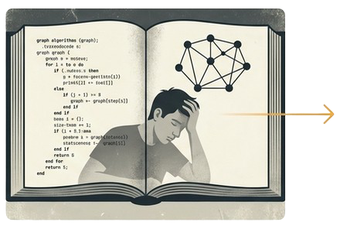
The Challenge: Learning Algorithms Can Be Abstract and Disconnected
Traditional methods often rely on "passive information transfer”.
This "one-size-fits-all" approach can fail to stimulate interest.
There is a significant need for interactive, student-centered tools.
Notes:
static diagrams and pseudocode that can lead to student disengagement.
, especially for students who struggle with abstract concepts.

Slide 3

The Evidence: Game-Based Learning Delivers Superior Outcomes
Recent empirical studies show that gamified environments can outperform traditional instructional methods in both cognitive learning and student motivation.
Boeker et al. (2013)
A study in medical education found students using a game-based tool achieved significantly higher scores on cognitive knowledge tests and reported higher levels of fun and engagement.
Gudadappanavar et al. (2021)
Research in pharmacology revealed gamified sessions led to a marked improvement in post-test knowledge scores and created an active, "student-centered” environment.
Our Position: Our work is designed as a powerful, supplementary
enhancement to the existing curriculum.

Slide 4
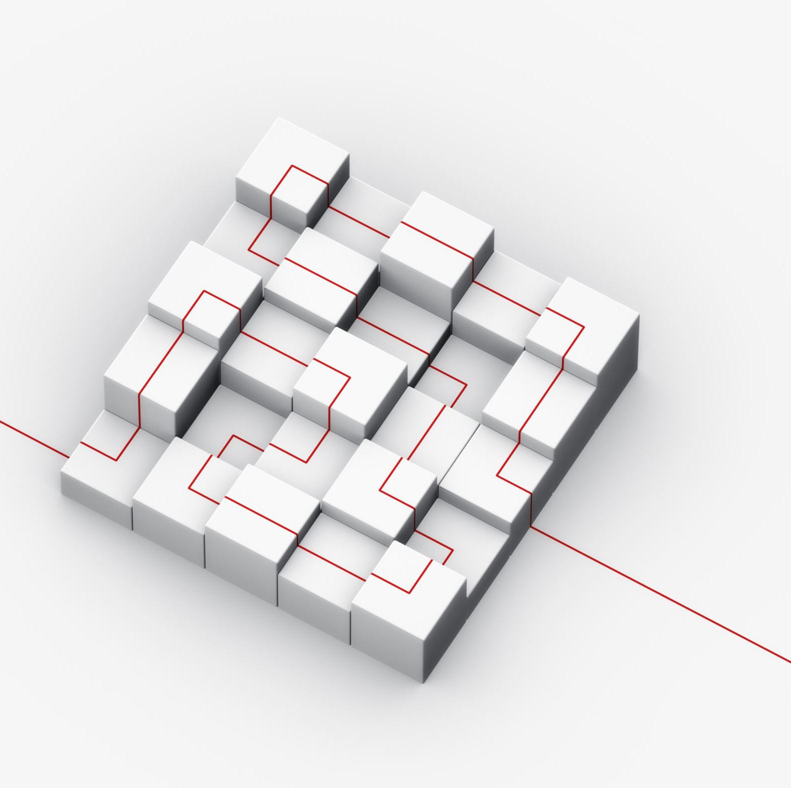
Our Solution: A Game to Make Algorithms Tangible
Project Definition Dynamic Labyrinths is an asymmetric multiplayer game designed to provide a unique and enjoyable approach to visualizing and learning pathfinding algorithms.
Central Idea
By immersing players in a competitive 3D environment where the map itself is variable, the game brings algorithmic logic to life. Players "feel" how map complexity impacts navigation.

Slide 5
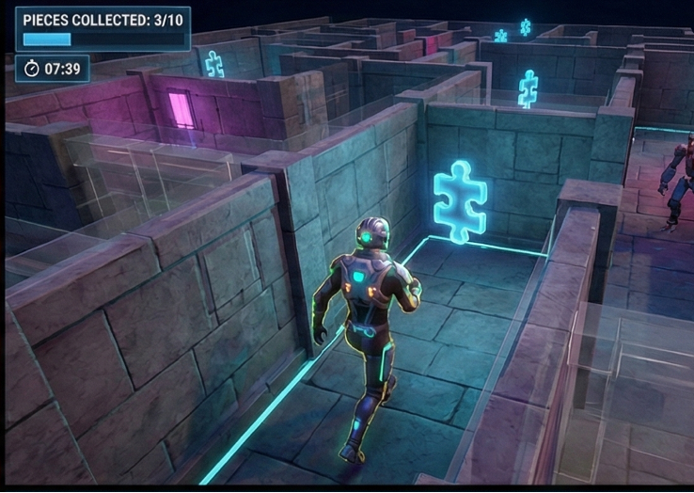
Two Roles, One Dynamic Battlefield
The Hunter
Objective: Navigate a complex 3D maze to collect puzzle pieces.
Challenge: Real-time navigation, obstacle avoidance, and making quick decisions to evade autonomous guard bots.

Slide 6
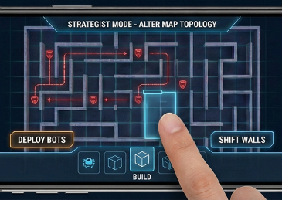
The Builder
Objective: Dynamically alter the map's topology in real-time.
Challenge: Strategically place walls and obstacles to assist the guard bots and oppose the Collector.

Slide 7





The Educational Engine: A Post-Round Algorithmic Analysis
The project's key contribution is an educational feedback loop that connects gameplay directly to algorithmic theory.
1. Analyze
After a round, the system
analyzes the final, unique map
configuration.
2. Calculate
A suite of different pathfinding algorithms calculates the theoretically optimal path from start to finish.
4. Visualize
A replay mode provides real-time decision-making suggestions based on the calculated optimal route, allowing players to see the algorithm in action.
3. Inform
The system presents the player with the specific algorithm that achieved the best performance for that map, along with educational context.

Slide 8



The Technology Powering the Experience
Unity Engine
The cross-platform
foundation for creating the
interactive 3D content,
using C# for implementing
complex game logic.
Cross-Platform Multiplayer
Built with Unity's Netcode for GameObjects (NGO) and Relay service to enable seamless connectivity between PC (Host) and mobile (Client).
Unity ML-Agents
An open-source toolkit used to transform the Unity environment in to a simulation for training intelligent agents via Reinforcement Learning.

Slide 9
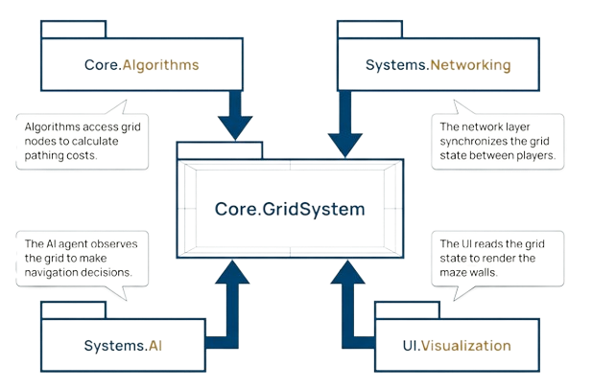
A Modular and Scalable System Architecture

Slide 10
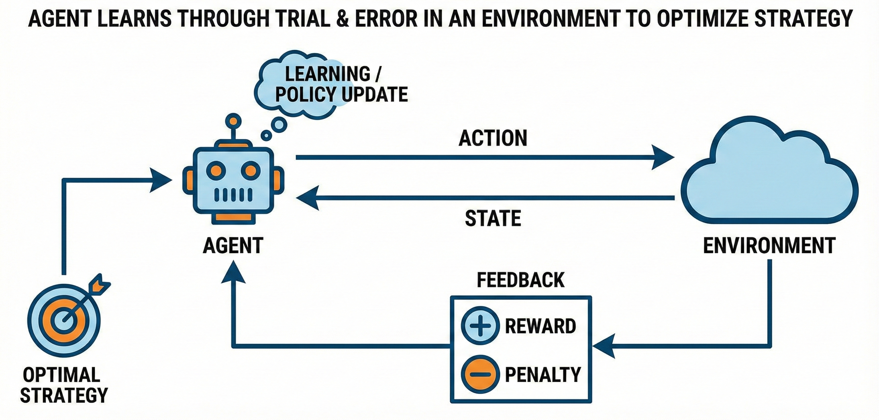
Training an Adaptive Opponent with Reinforcement Learning
Application in Dynamic Labyrinths
We generate an ML agent that acts as an autonomous guard bots.
This agent is trained to compete against the player, learning to navigate the dynamic mazes created by the Builder.
The result is a challenging opponent that can adapt its strategy to the changing environment without being explicitly programmed for every scenario.

Slide 11
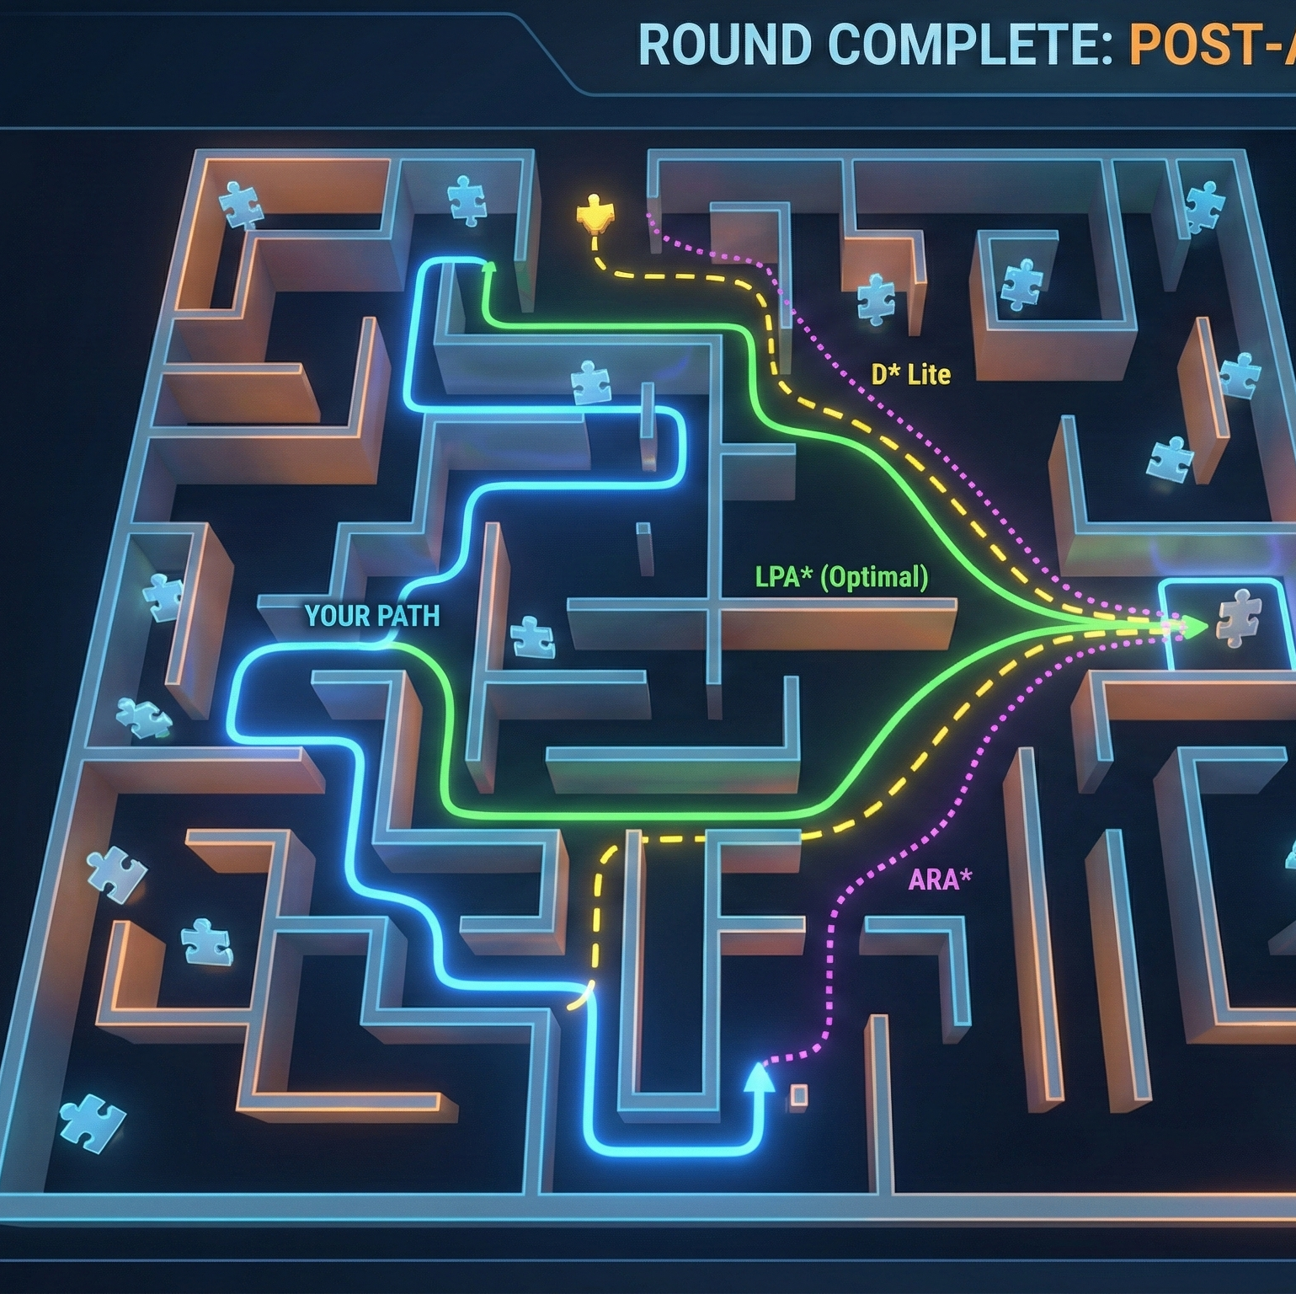
Pathfinding Algorithms
LPA*: Designed specifically for dynamic environments like our changing mazes.
D* Lite: Optimized for navigation where terrain is unknown or shifting.
ARA*: Balances calculation speed with solution perfection.

Slide 12

Defining Success: Core Functional Requirements
Visually render the step-by-step execution of pathfinding algorithms.
Support cross-platform multiplayer sessions (PC Host, Mobile Client).
Generate a competitive Machine Learning agent.
Display educational information on the optimal algorithm for each map.
Allow the mobile player to add obstacles in real-time.
Enable replayability of maps with optimal path visualization.
Show the time taken for the optimal algorithm to solve the map.

Slide 13




Ensuring a Quality Experience: Non-Functional Goals
Performance & Compatibility
The game will be fully functional on Windows and Android, with synchronized multiplayer game states.
Usability
The Ul will automatically adapt to different screen resolutions, and input handling will be consistent across mouse and touchscreen devices.
Reliability
All implemented pathfinding algorithms will produce Mathematically accurate results.
Engagement
The game will be fun and successfully achieve its educational purpose.

Slide 14

Our Commitment to Quality: Verification and Evaluation
We utilize the industry-standard Unity Test Framework (UTF) for automated testing.
Evaluation Strategy (What We Measure)
Algorithmic Integrity: Verifying the mathematical accuracy of pathfinding logic.
System Performance: Measuring network stability and latency between devices.
ML-Agent Proficiency: Assessing the Al agent’s intelligence and behavior.
Educational Efficacy: Evaluating the design's effectiveness in teaching concepts.

Slide 15
Verification Tools (How We Test)
EditMode Tests
Unit tests for algorithms, run instantly in the editor.
PlayMode Tests
Integration tests to verify game mechanics during real-time execution.
Performance Testing Extension
Benchmarking tools to measure execution time and memory usage.

Slide 16



Navigating Development: Key Challenges and Learnings
We adopted an iterative “learn-by-doing” methodology, supplementing a foundational Unity course with extensive research into documentation and developer forums.
Optimization for Mobile Hardware
The computational expense of pathfinding required strict memory and resource management to prevent battery drain and maintain stable frame-rates on Android.
Cross-Platform Synchronization
Ensuring minimal latency and a consistent UI/UX between PC (mouse) and mobile (touch) was a complex networking and design challenge.
ML-Agent Training
The primary difficulty was training a neural network that was both intelligent enough to be a challenge and computationally light enough to run locally on a mobile device.

Slide 17

Impact: Where Intuition Meets Algorithmic Insight
Summary: Dynamic Labyrinths is more than a game. it is a successful visualization tool that gamifies the differences between heuristic and non-heuristic search methods.
The Core Value: It provides an intuitive understanding of how different algorithms adapt to complex, dynamic environments.
Final Takeaway: By allowing players to directly interact with a constantly changing graph, the project transforms abstract computational concepts into a tangible, memorable experience.

Slide 18
Thank You! Questions?

